Slide 1
E&B WINDOW FILM
Coating Suisse, Ltd.
Binningerstrasse 141, CH 4123 Allschwil BL, Schweiz , Suisse, Switzerland
Tel. +41 61 501 80 86 Cell + 41 76 675 19 49, Email. info@coating-Suisse.ch,
Homepage. www.coating-suisse.ch

Slide 2
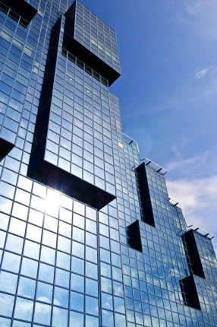
A researcher, manufacturer and reseller of producing energy efficient products and providing with energy saving solution in variety of industries.
1
About E&B
-1
GREETINGS
E&B Co., Ltd. is a quality-controlled manufacturer of the following products in environment-friendly and energy-saving field and represented by COATING SUISSE Ltd, Switzerland as a General Representation for the European and Middle East market.
- Multi-functional window films
- Conducting materials
- Power saving LED substances
Since the establishment, E&B has been practicing to achieve the dreams and visions of customers and employees by transparent management and creating values in global-leading standard.
We stay focused on our core strategic markets where our products offers an advantage to customers. We invest in our people, process, equipment and technology and we keep exceeding the customers’ expectation and receiving fair value in return.
E&B is striving to be the innovative and creative global leader in industry. And we never stop giving its best effort.

Slide 3
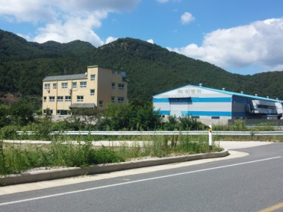
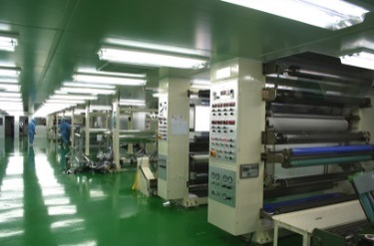
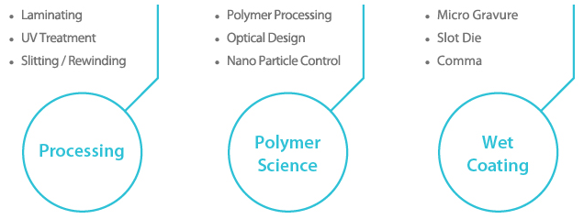
A researcher and manufacturer of producing energy efficient products and providing with energy saving solution in variety of industries.
1
About E&B
-2
WINDOW FILM MANUFACTURING
E&B is a leading company specialized in developing and manufacturing energy-efficient window film with innovative nano-ceramic coating materials and patented multi-coating technology.
Through the continuous dedication to R&D investment and with our own patented technology, we’re empowering the window films to the highest standard of quality and performance.
Technology-oriented R&D
Customer-centered Service
Quality-controlled Manufacturer

Slide 4
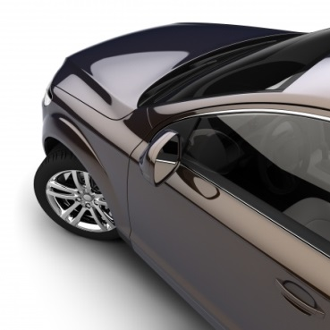
A researcher and manufacturer of producing energy efficient products and providing with energy saving solution in variety of industries.
2
E&B Window Film
-1
PERFORMANCE
Solar Heat Rejection
IR rejection upto 99%
World-leading TSER performance by state-of-art nano technology
Glare Reduction
More comfortable view by reduction of excessive sunlight
Available with wide range of VLTs(visible light transmittance)
Harmful UV-ray Block
Blocking almost 100% of harmful UV-ray
Protection from skin damage and color fading of furniture, etc.
Safety and Security
Protection from intrusion or robbery from outside
Preventing secondary damages from shattered glasses

Slide 5
A researcher and manufacturer of producing energy efficient products and providing with energy saving solution in variety of industries.
2
E&B Window Film
-2
DIVERSITY OF FILMS
Low-E
Chameleon
Price
Sputter IR
Dyed
IR
Ceramic IR
Dyed Reflective
Carbon
Reflective
Pigment
Dyed
(1ply/2ply)
Glue Reflective
Glue
(1ply/2ply)
Performance

Slide 6
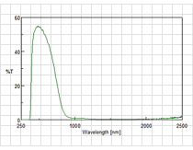
A researcher and manufacturer of producing energy efficient products and providing with energy saving solution in variety of industries.
3
E&B Film Specialty
-1
Superior IR Film
Remarkable TSER
IR(infrared ray) rejection upto 99%
IR rejection through whole wavelength of IR radiation
Maximizing heat-shielding performance by patented nano technology
Outstanding Durability
Dye-free film
No fading / No color-change / No IR-decline
Wide range of color matching
Crystal Clarity
Outstanding optical clarity
Ultra-transparency (haze level 0.7 as finish product)
Free from blue-foggy

Slide 7
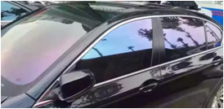
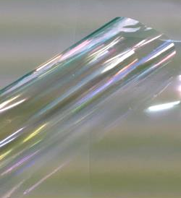
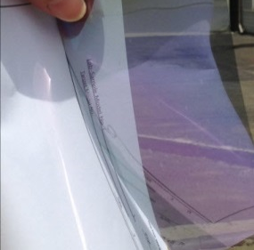
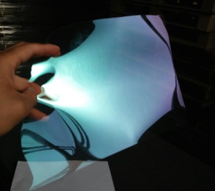
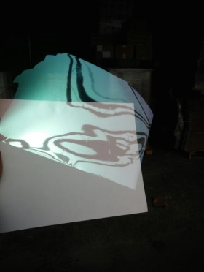
A researcher and manufacturer of producing energy efficient products and providing with energy saving solution in variety of industries.
3
E&B Film Specialty
-2
Chameleon Film
What’s Chameleon Film?
As known as multi-layer film, Chameleon film has very unique colors and appearance by over 100 layers of polyester
Showing different colors depending on the angle of view.
Non-metal, free from corrosion
No interference for GPS devices.
Stella A (Light Chameleon)
Stella B (Deep Chameleon)

Slide 8
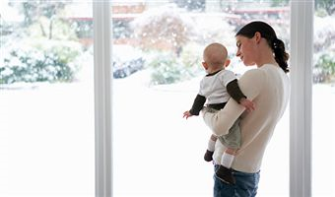
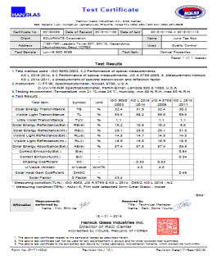
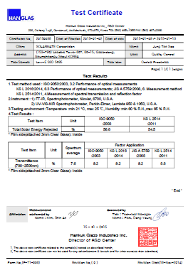
A researcher and manufacturer of producing energy efficient products and providing with energy saving solution in variety of industries.
3
E&B Film Specialty
-3
Low-E Film
What’s Low-E Film?
Low-E film has special coating to lower the emissivity of the film and it reduces the radiant heat loss through the glass.
When the interior warm air tries to escape to the colder outside during the winter, the Low-E coating becomes a barrier and reflects the heat back to inside.
E&B Low-E Film
Test Certificate
 | U-Value (W/㎡K) | Emissivity (Interior)
Ceramic film | 6.0 | 0.88
Metalized film | 5.8 | 0.76
Sputtered film | 5.6 | 0.70
E&B Low-E Film (Eclips 50) | 4.5 | 0.34

Slide 9
A researcher and manufacturer of producing energy efficient products and providing with energy saving solution in variety of industries.
4
E&B Automotive Film
-1
Premium Grade
AEGIS SERIES
AEGIS (AG) is non-reflective black IR film in premium grade, which ensure more privacy and less glare while maximizing solar-rejection performance in outstanding durability.
Product | Visible Light |  | IR Reject (%) |  | UV Block (%) | TSER | Thickness | Color | Warranty | Size
 | Transmit. (%) | Reflect. (%) | ~ 950nm | ~1400nm
AG 05 | 7 | 6 | 95 | 99 | 99 | 70 | 2mil | Black | 7 years | 1.52M X 30M (60in X 100ft)
AG 15 | 12 | 5 | 95 | 99 | 99 | 65 | 2mil | Black | 7 years
AG 35 | 30 | 6 | 95 | 99 | 99 | 59 | 2mil | Black | 7 years
AG P-45 | 45 | 8 | 90 | 99 | 98 | 52 | 2mil / 5mil | Black | 7 years | 1.52M X 30M (60in X 100ft)
AG P-50 | 55 | 8 | 90 | 99 | 98 | 49 | 2mil / 5mil | Black | 7 years
AG E-10 | 11 | 6 | 80 | 90 | 99 | 66 | 2mil | Black | 7 years | 1.52M X 30M (60in X 100ft)
AG E-20 | 20 | 6 | 80 | 90 | 99 | 61 | 2mil | Black | 7 years
AG E-35 | 35 | 7 | 80 | 90 | 99 | 54 | 2mil | Black | 7 years

Slide 10
A researcher and manufacturer of producing energy efficient products and providing with energy saving solution in variety of industries.
4
E&B Automotive Film
-2
Premium Grade
BASTIAN SERIES
BASTIAN (BS) is non-reflective IR films with dyed film.
Dyed film has exceptional clarity and the most comfortable view. And BASTIAN is upgraded with even higher solar-rejection.
Product | Visible Light |  | IR Reject (%) |  | UV Block (%) | TSER | Thickness | Color | Warranty | Size
 | Transmit. (%) | Reflect. (%) | ~ 950nm | ~1400nm
BS E-05 | 4 | 8 | 80 | 90 | 99 | 65 | 2mil | Black | 3 years | 1.52M X 30M (60in X 100ft)
BS E-15 | 12 | 5 | 80 | 90 | 99 | 63 | 2mil | Black | 3 years
BS E-35 | 30 | 6 | 80 | 90 | 99 | 56 | 2mil | Black | 3 years
BS E-35C
** Bastian 35C is specially developed as it is free from milky (also known as blue-foggy) appearance.

Slide 11
A researcher and manufacturer of producing energy efficient products and providing with energy saving solution in variety of industries.
4
E&B Automotive Film
-3
Premium Grade
GARDIAN SERIES
GARDIAN (GD) is hybrid IR film by combination of sputtering and nano-ceramic coating.
It delivers the most effective and efficient solar rejection by heat-reflecting and heat-absorbing.
Product | Visible Light |  | IR Reject (%) |  | UV Block (%) | TSER | Thickness | Color | Warranty | Size
 | Transmit. (%) | Reflect. (%) | ~ 950nm | ~1400nm
GD P-05 | 9 | IN. 10 / EX. 9 | 90 | 98 | 99 | 69 | 2mil | Black | 5 years | 1.52M X 30M (60in X 100ft)
GD P-15 | 20 | IN. 10 / EX. 10 | 90 | 98 | 99 | 65 | 2mil | Black | 5 years
GD P-35 | 35 | IN. 10 / EX. 7 | 90 | 98 | 99 | 61 | 2mil | Black | 5 years
GD L-05 | 7 | IN. 8 / EX. 9 | 60 |  | 99 | 57 | 2mil | Black | 5 years | 1.52M X 30M (60in X 100ft)
GD L-15 | 15 | IN. 6 / EX. 6 | 60 |  | 99 | 46 | 2mil | Black | 5 years
GD L-35 | 35 | IN. 6 / EX. 7 | 60 |  | 99 | 43 | 2mil | Black | 5 years

Slide 12
A researcher and manufacturer of producing energy efficient products and providing with energy saving solution in variety of industries.
4
E&B Automotive Film
-4
Premium Grade
KRYSTAL SERIES
KRYSTAL (KR) is non-reflective nano-ceramic IR film for windshield, which developed from state-of-art nano technology.
KRYTSTAL delivers the highest standard of clarity, durability and solar-rejection performance.
Product | Visible Light |  | IR Reject (%) |  | UV Block (%) | TSER | Thickness | Color | Warranty | Size
 | Transmit. (%) | Reflect. (%) | ~ 950nm | ~1400nm
KR 70 | 70 | 9 | 90 | 92 | 99 | 44 | 1.5mil / 3mil | Blue | 7 years | 1.52M X 30M (60in X 100ft)
KR 70-GN | 70 | 10 | 90 | 92 | 99 | 43 | 1.5mil | Green | 7 years
KR 75 | 75 | 10 | 78 | 90 | 99 | 42 | 1.5mil | Blue | 7 years
KR 80 | 80 | 11 | 60 | 80 | 99 | 33 | 1.5mil | Blue | 7 years
KR 70C | 70 | 10 | 90 | 98 | 99 | 45 | 1.5mil | Blue | 7 years | 1.52M X 30M (60in X 100ft)
KR 75C | 75 | 11 | 80 | 90 | 99 | 40 | 1.5mil | Blue | 7 years
KR M-90 | 88 | 12 | 40 | 80 | 99 | 30 | 2mil | Clear | 7 years
** KR 70C and KR 75C are specially developed as it is free from milky (also known as blue-foggy) appearance.
** KR M-90 is super nano-ceramic IR film with extreme solar-rejection performance.

Slide 13
A researcher and manufacturer of producing energy efficient products and providing with energy saving solution in variety of industries.
4
E&B Automotive Film
-5
Economy Grade
GLUE-TYPE (Non-Ref. / Ref.)
E&B Window Film offers GLUE-TYPE as economy-graded tinting films with high quality in good price.
Category | Product (example) | Reflective | VLT (%) | UV Block (%) | Color | Thickness | Packaging Size
Glue 1ply | G1-BK 01 | Non-Ref. | 1 | 99 | Black Charcoal Smoke Graphite | 1mil | 1.52M X 30M (60in X 100ft) 1.52M X 600M (60in X 2000ft)
 | G1-BK 05 | Non-Ref. | 5 | 99 |  | 1mil
 | G1-BK 25 | Non-Ref. | 25 | 99 |  | 1mil
 | G1-BK 35 | Non-Ref. | 35 | 99 |  | 1mil
 | G1-BK 50 | Non-Ref. | 50 | 99 |  | 1mil
Glue Reflective | GR-BL 05 | Reflective | 5 | 99 | Silver Blue Bronze Green Gold | 1.5mil | 1.52M X 30M (60in X 100ft) 1.52M X 600M (60in X 2000ft)
 | GR-BK 25 | Reflective | 25 | 99 |  | 1.5mil
 | GR-BK 35 | Reflective | 35 | 99 |  | 1.5mil
** GLUE-TYPE (non-reflective) is also available in 2ply 1.5mil.

Slide 14
A researcher and manufacturer of producing energy efficient products and providing with energy saving solution in variety of industries.
4
E&B Automotive Film
-6
Economy Grade
DYED FILM (Non-Ref. / Ref.)
DYED FILM is produced by colored polyester. It has solid color and great appearance.
Category | Product | Reflective | VLT (%) | UV Block (%) | Color | Thickness | Packaging Size
Dyed 1ply | D1-BK 05 | Non-Ref. | 5 | 99 | Black | 1.5mil | 1.52M X 30M (60in X 100ft) 1.52M X 600M (60in X 2000ft)
 | D1-BK 15 | Non-Ref. | 15 | 99 |  | 1mil
 | D1-BK 25 | Non-Ref. | 25 | 99 |  | 1mil
 | D1-BK 35 | Non-Ref. | 35 | 99 |  | 1mil
 | D1-BK 50 | Non-Ref. | 50 | 99 |  | 1mil
Dyed Reflective | DR-BK 05 | Reflective | 5 | 99 | Black | 2mil | 1.52M X 30M (60in X 100ft) 1.52M X 600M (60in X 2000ft)
 | DR-BK 15 | Reflective | 15 | 99 |  | 1.5mil
 | DR-BK 25 | Reflective | 25 | 99 |  | 1.5mil
 | DR-BK 35 | Reflective | 35 | 99 |  | 1.5mil
 | DR-BK 50 | Reflective | 50 | 99 |  | 1.5mil
** DYED FILM (Non-reflective) is also available in 2ply and various thickness

Slide 15
A researcher and manufacturer of producing energy efficient products and providing with energy saving solution in variety of industries.
4
E&B Automotive Film
-7
Economy Grade
PIGMENT FILM (Non-Ref.)
PIGMENT FILM is produced by carbon and inorganic pigments. Unlikely to glue-type or dyed film, PIGMENT FILM has outstanding durability against fading and color changing.
Category | Product | Reflective | VLT (%) | UV Block (%) | Color | Thickness | Packaging Size
Pigment 1ply | C1-BK 05 | Non-Ref. | 5 | 99 | Black Charcoal | 1mil | 1.52M X 30M (60in X 100ft) 1.52M X 600M (60in X 2000ft)
 | C1-BK 15 | Non-Ref. | 15 | 99 |  | 1mil
 | C1-BK 25 | Non-Ref. | 25 | 99 |  | 1mil
 | C1-BK 35 | Non-Ref. | 35 | 99 |  | 1mil
 | C1-BK 50 | Non-Ref. | 50 | 99 |  | 1mil
** Pigment Film is also available in 2ply 1.5mil.

Slide 16
A researcher and manufacturer of producing energy efficient products and providing with energy saving solution in variety of industries.
5
E&B Architectural Film
-1
Low-E Film
ECLIPS SERIES
ECLIPS SERIES (EC) is state-of-art Low-E Film with great performance of summer effect and winter effect.
In summer, it rejects solar heat from outside. In winter, it keeps the warm air inside.
It is true energy saving for 4 seasons in all climates.
Product | Visible Light (%) |  |  | IR Reject (%) | UV Block (%) | TSER | U-Value (W/㎡K) | Emissivity (in) | Size
 | Transmit. | Reflect. (in) | Reflect. (ex)
EC 50 | 60 | 15 | 19 | 95 | 99 | 59 | 4.5 | 0.34 | 1.52M X 30M (60in X 100ft)
EC 80 | 76 | 21 | 21 | 50 | 99 | 38 | 4.8 | 0.48

Slide 17
A researcher and manufacturer of producing energy efficient products and providing with energy saving solution in variety of industries.
5
E&B Architectural Film
-2
Superior IR Film
PRIME SERIES
PRIME SERIES (PR) reduces great amount of solar heat passing through the glass to indoor.
Nano-ceramic coating and metal sputtering achieve more efficient and more effective way of heat-shielding performance.
Product | Visible Light (%) |  |  | IR Reject (%) | UV Block (%) | TSER | U-Value (W/㎡K) | Shading Coefficient | Size
 | Transmit. | Reflect. (in) | Reflect. (ex)
PR E-50 | 50 | 15 | 20 | 95 | 99 | 58 | 5.6 | 0.50 | 1.52M X 30M (60in X 100ft)
PR S-45 | 45 | 12 | 13 | 95 | 99 | 54 | 5.8 | 0.53
PR S-15B | 16 | 11 | 15 | 98 | 99 | 67 | 5.8 | 0.38

Slide 18
A researcher and manufacturer of producing energy efficient products and providing with energy saving solution in variety of industries.
5
E&B Architectural Film
-3
Safety Film
PROTEC SERIES
PROTEC SERIES (PT) is safety film, which upgrades the glass to safety glass in more effective way.
It also prevents the secondary damages from shattered glass. In addition, it blocks almost 100% of harmful UV rays.
Product | Visible Light Transmit. (%) | UV Block (%) | Color | Thickness (mm) | Tensile Strength (N/10㎜) | Elongation (%) | Adhesion Strength (N/10㎜)
Protec 140 | 88 | 99 | Clear | 0.12 | 155 | 180 | 4.6
Protec 280 | 88 | 99 | Clear | 0.19 | 331 | 140 | 3.8
Protec 3120 | 88 | 99 | Clear | 0.35 | 491 | 90 | 2.3
PT 140-SV15 | 15 | 99 | Silver | 0.12 | 138 | 165 | 4.5

Slide 19
Head Office Schweiz
Binningerstrasse 141
CH 4123 Allschwil-BL
Tel : +41-61 -501 80 86
Cell: +41-76-675 19 49
Email : Info@coating-Suisse.ch
Website : http://www.coating-Suisse.com
Sales Office Schweiz
Birsigtalstrasse 5 CH 4153 Reinach
THANK YOU

